Slide 1

STAINLESS STEEL AS REINFORCEMENT
BY- Bhrugesh Patel
SD-1210
STRUCTURAL DEPARTMENT
CEPT UNIVERSITY

Slide 2
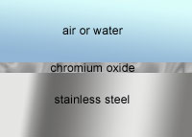
Introduction
Stainless steel is low carbon steel. It is an alloy of iron with chromium content over 10.5%.Also nickel, molybdenum and certain other alloying elements are added
Chromium is the alloying element that imparts to stainless steel their corrosion resistance qualities

Slide 3
Types Of Stainless Steel
Austenitic
Ferritic
Austenitic-ferritic (duplex)
Martensitic
Some of the commonly used grades of stainless steel for rebar applications are type 304,316(austenitic) and 2205(duplex).
The alloy is selected based on mechanical properties and the expected exposure or corrosivity of the service environment, i.e. the level of corrosion resistance required.

Slide 4
Austenitic
It is made by adding nickel (from 8 to 25 percent) and increasing the chromium level (from 17 to 25 percent). Molybdenum can also be added (up to 7 percent) to increase the corrosion resistance.
Basic properties:
  Excellent corrosion resistance in organic acid, industrial and marine environments.
  Excellent weld ability.
  Excellent formability, fabric ability and ductility.
  Excellent clean ability, and hygiene characteristics.
  Good high and excellent low temperature properties (high
  toughness at all temperatures)
  Non magnetic.

Slide 5
Ferritic
Ferritic stainless steel has properties similar to mild steel but with the better corrosion resistance. These alloys are somewhat less ductile than the austenitic types. These are plain chromium stainless steels with varying chromium content between 12 and 18%, but with low carbon content.
Basic properties:
  Moderate to good corrosion resistance increasing with
  chromium content.
  Not hardenable by heat treatment and always used in the annealed condition .
  Magnetic
  Weld ability is poor.
  Formability not as good as the austenitic

Slide 6
Austenitic-ferritic (Duplex)
Austenitic-ferritic (duplex) duplex stainless steels is a combination of both ferritic and austenitic. They have a high chromium content (from 18 to 26 percent) and a low nickel content (from 4 to 7 percent). Most grades also contain some molybdenum (from 2 to 3 percent).
Basic properties:
  High resistance to stress corrosion cracking
  Increased resistance to chloride ion attack
  Higher tensile and yield strength than austenitic or ferritic steels
  Good weld ability and formability

Slide 7
Martensitic
Martensitic stainless steel contains mostly 11 to 13% chromium and is both strong and hard with moderate corrosion resistance. Martensitic stainless steels were the first stainless steels commercially developed and have relatively high carbon content (0.1 - 1.2%) compared to other stainless steels
Basic properties
  Moderate corrosion resistance
  Can be hardened by heat treatment and therefore high strength and hardness levels can be achieved
  Poor weld ability
  Magnetic

Slide 8
Properties Of Stainless Steel
Yield strength MPa (min)
Tensile
strength MPa (min)
Elong
%
(min)
Grade
UNS No
Family
Cr^{c}
Ni^{c}
Mo^{c}
N^{c}
C
(max)
430
S43000
Ferritic
17
0.12
205
450
22
13
0.15
(min)
1720
8
420
S42000
Martensitic
1480
304
S30400
Austenitic
515
18
9
0.08
205
40
304L
S30403
Austenitic
485
18
9
0.03
170
40
316
S31600
Austenitic
515
17
11
2.1
0.08
205
40
316L
S31603
Austenitic
485
17
11
2.1
0.03
170
40
S31803
S32205
Duplex
0.03
450
620
25
2205
22
5
3
0.15

Slide 9
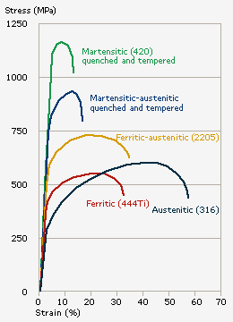
Stress-Strain Curve

Slide 10
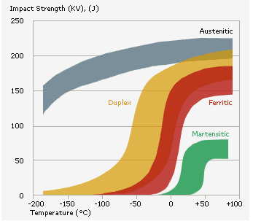
Toughness of stainless steel

Slide 11
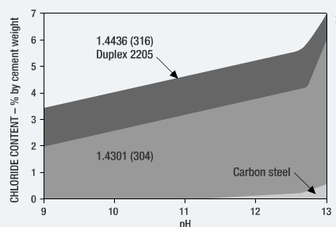
Corrosion resistivity of stainless steel
Carbone steel can only tolerate chloride from 0 to 0.4%
Stainless steel can tolerate chloride of 7% (depending upon grade)
The concrete ph reduce Carbone steel tolerate less amount of chloride and stainless steel tolerate high amount of chloride which is not normally encounter in civil structure.

Slide 12
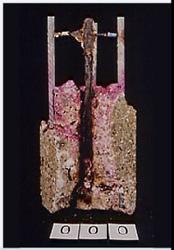
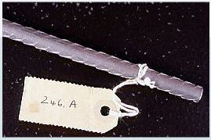
Stainless steel rebar is highly resistance to chloride irons in concrete.
22year + exposure test in concrete with 3.2% calcium chloride.
Carbone steel is completely corroded.
Stainless steel bar as good as the day they went in.

Slide 13
Use of stainless steel
    Marine structures, bridge decks, sidewalks, ramps, parapets, pilings, barriers, retaining walls, anchoring systems, parking garages, sea walls, columns, piers, jetties.
    Anchorages and any kind of joints
    Offshore platforms
    Tunnels, underpasses and subways
    Bridges, viaducts, overpasses
    Historic buildings

Slide 14
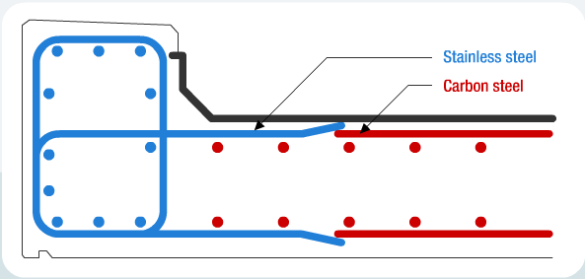
cost effective use of stainless steel
By placing element at high risk of corrosion or where repair is difficult and expensive.
The carbon steel is placed at the depth where its is unlikely to attack by chloride iron.

Slide 15
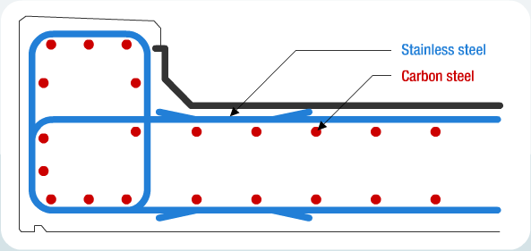

Slide 16
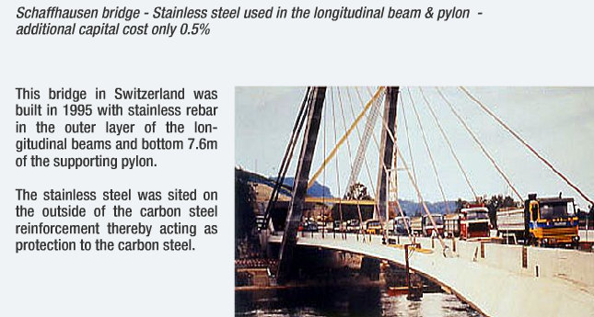
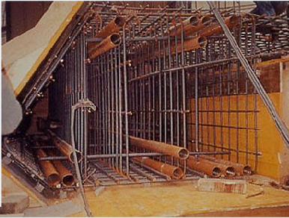

Slide 17
Cost analysis
Installment cost
Material cost
Maintenance cost
Lost product cost
Replacement cost
Installment cost
Material cost
stainless steel carbon steel
initial cost of stainless steel is high.
For carbon steel initial cost is not high but after some year say 20 to 25 it needs maintenance and replacement.

Slide 18
Actual life costing of stainless steel

Slide 19
UK Midlands Link Viaduct
Built in 1972 at a cost of £28 million, evidence of corrosion became apparent after two years of operation.
By 1989, £45 million had been spent on repair.
By 2010 it is estimated that a further £120 million will be spent on repair.
Estimated first cost of installing stainless steel reinforcement in critical locations -- £3.4 million (i.e. a 12% increase in the initial cost of the via duct).
The total cost of repair of the carbon steel reinforcement till the year 2010 would be £45 plus a further £120 million = £165 million or nearly six times the original cost of building the viaduct. For a 40-year service life of the viaduct, the price to be paid for not using stainless steel rebar.

Slide 20
Advantage of stainless steel
Highly resistance to corrosion.
Concrete cover can be reduced.
It improve durability.
It reduce maintenance and repair.
It can be used selectively for high risk elements cost effectively.
It will eventually recycled.
Good weld ability for common rebar grades.
Fire and heat resistance.
Environmentally friendly.

Slide 21
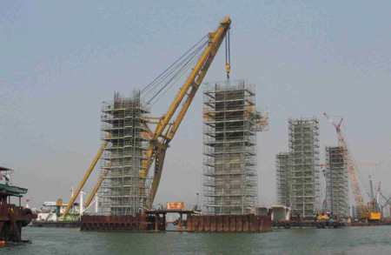
Shenzhen Western Corridor Bridge
Some 1,250 tones of stainless steel S31600 (containing 12% nickel) and duplex stainless steel (containing 5.5% nickel) will be used to reinforce select portion of a major three-lane highway bridge in Hong Kong.

Slide 22
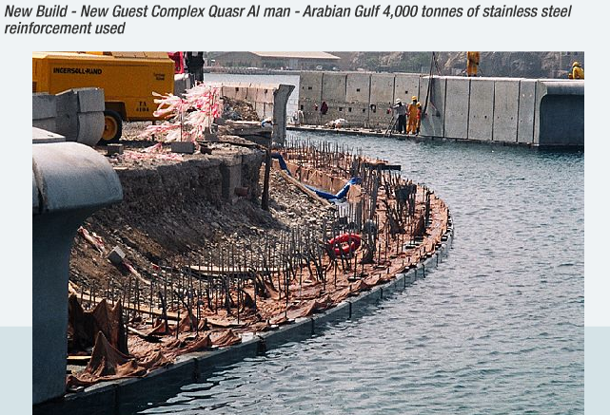

Slide 23
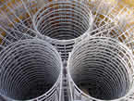
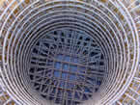
Nuclear Plant In France: Stainless Steel Has Been Used to Build Ferroconcrete Drums for Disposal of Radioactive Nuclear Wastes. In This Application, for Safety Reasons, Is Mandatory the Use Stainless Steel in Order to Avoid Cracks in the Concrete (Caused by Reinforcing Bars Corrosion) and Subsequent Waste Leaking

Slide 24
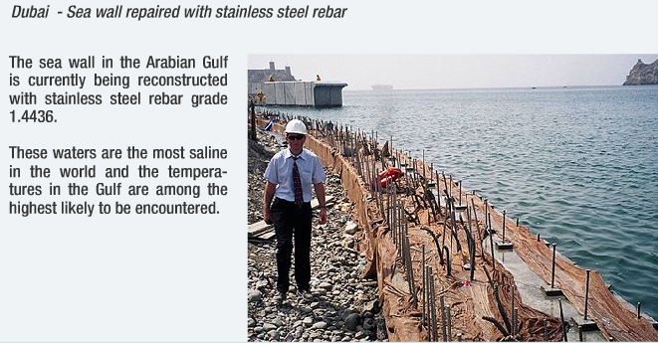

Slide 25
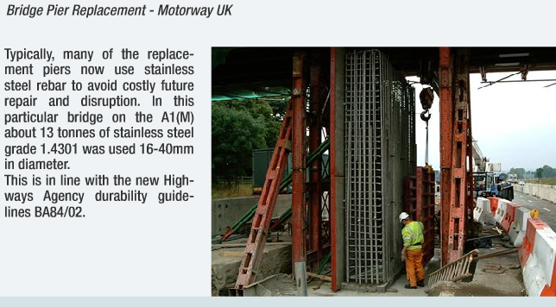

Slide 26
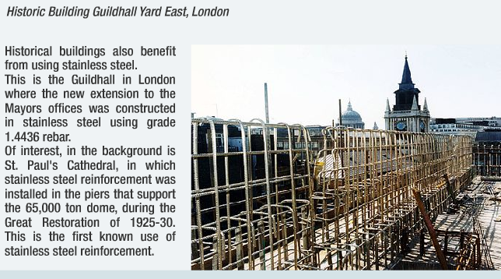

Slide 27
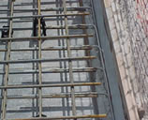
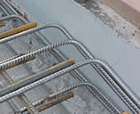
Glandstone Bridge, Queenslans, Australia
The Gladstone Bridge Was Built in 1960 and Showed Corrosion of the Reinforcing Mild Steel on the Deck.
The Maintenance Works Have Seen the Use of 12 Mm Diameter Stainless Steel Ribbed Bars Type 316L Joined With the Original Carbon Steel

Slide 28
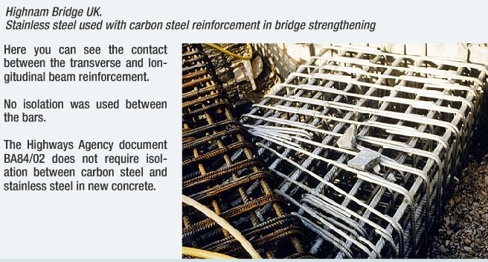

Slide 29
References
http://www.worldstainless.org/
http://www.outokumpu.com/
http://www.imoa.info/
http://www.stainlessconstruction.com/
http://www.reval-stainless-steel.com/
http://www.nickelinstitute.org/
http://www.sintef.no/
K Mani and P Srinivasan-“Service life of RC structures in Corrosive Environment: A comparison of carbon steel And Stainless steel Bars”- Indian Concrete Journal, Volume 75,1-12,2001.
Y Sakumoto, T Nakazato and A Matsuzaki- “Properties of Stainless Steel For Building Structures”- ASCE Journal Of Structural Engineering, Volume 122,1-6,1996

Slide 30


